Slide 1
Analysis of Algorithms
Parinya Sanguansat

Slide 2
Why we need to analyze algorithm?
One task can be done by many algorithms
Which algorithm is better?
We need a tool for comparing the algorithms
We need quick and small algorithm
Quick
Processing time
Small
Memory usage

Slide 3

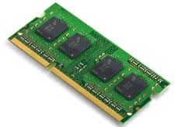
What is analysis of algorithms?
The determination of the amount of resources (such as time and storage) necessary to execute them
Time and Storage relation

Slide 4
Run-time Analysis
Empirical metrics
Programming
Run
Measure elapsed time
Example: Find maximum difference pair in an array
20 | 12 | 8 | 14 | 5
15

Slide 5
Find maximum difference pair in an array
Algorithm 1
static int MaxDiff1(int[] a)
{
int maxdiff = 0;
for (int i = 0; i < a.Length; i++)
for (int j = 0; j < a.Length; j++)
{
int diff = Math.Abs(a[i] - a[j]);
if (diff > maxdiff)
maxdiff = diff;
}
return maxdiff;
}

Slide 6
Find maximum difference pair in an array
Algorithm 2
static int MaxDiff2(int[] a)
{
int maxdiff = 0;
for (int i = 0; i < a.Length; i++)
for (int j = i + 1; j < a.Length; j++)
{
int diff = Math.Abs(a[i] - a[j]);
if (diff > maxdiff)
maxdiff = diff;
}
return maxdiff;
}

Slide 7
Find maximum difference pair in an array
Algorithm 3
static int MaxDiff3(int[] a)
{
int max = int.MinValue;
int min = int.MaxValue;
for (int i = 0; i < a.Length; i++)
{
if (a[i] > max) max = a[i];
if (a[i] < min) min = a[i];
}
return max - min;
}

Slide 8
Elapsed Time in C#
System.Diagnostics.Stopwatch
using System.Diagnostics;
Stopwatch watch = new Stopwatch();
watch.Reset();
watch.Start();
// Do something
watch.Stop();

Slide 9
Chart in C#
System.Windows.Forms.DataVisualization.Charting.Chart
chart1.ChartAreas[0].AxisX.Title = "x"; // x label
chart1.ChartAreas[0].AxisY.Title = "y"; // y label
chart1.Series.Clear(); // remove default series
Series data = chart1.Series.Add("Data");
data.ChartType = SeriesChartType.Line;
data.MarkerStyle = MarkerStyle.Circle;
for (int n = 1; n < 100; n++)
{
data.Points.AddXY(n, n*n); // add x-y point
chart1.Update(); // real-time updating
}

Slide 10
Visualization
private void button1_Click(object sender, EventArgs e)
{
try
{
int maxn = int.Parse(textBox1.Text);
chart1.ChartAreas[0].AxisX.Title = "n";
chart1.ChartAreas[0].AxisY.Title = "ms";
chart1.Series.Clear();
Series algo1 = chart1.Series.Add("Algo1");
algo1.ChartType = SeriesChartType.Line;
algo1.MarkerStyle = MarkerStyle.Circle;
Series algo2 = chart1.Series.Add("Algo2");
algo2.ChartType = SeriesChartType.Line;
algo2.MarkerStyle = MarkerStyle.Circle;
Series algo3 = chart1.Series.Add("Algo3");
algo3.ChartType = SeriesChartType.Line;
algo3.MarkerStyle = MarkerStyle.Circle;
Stopwatch watch = new Stopwatch();
for (int n = 1; n < maxn; n *= 2)
{
int[] a = new int[n];
watch.Reset();
watch.Start();
MaxDiff1(a);
watch.Stop();
algo1.Points.AddXY(n,
watch.ElapsedMilliseconds);
watch.Reset();
watch.Start();
MaxDiff2(a);
watch.Stop();
algo2.Points.AddXY(n,
watch.ElapsedMilliseconds);
watch.Reset();
watch.Start();
MaxDiff3(a);
watch.Stop();
algo3.Points.AddXY(n,
watch.ElapsedMilliseconds);
chart1.Update();
}
}
catch
{
MessageBox.Show("Please input number");
}
}

Slide 11
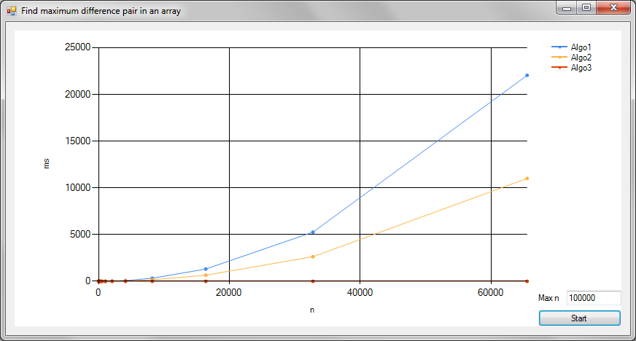
Algo1 vs Algo2 vs Algo3

Slide 12


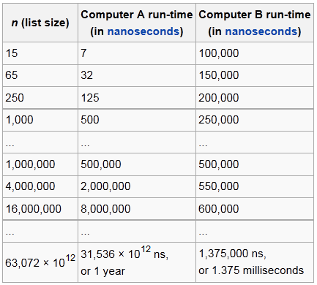
Growth rate analysis
Empirical metrics
Machine dependent?
Example: Sorting n elements
Computer A run algorithm A
Computer B run algorithm B
Machine independent
Count the number of the significant steps
Is A better than B?

Slide 13
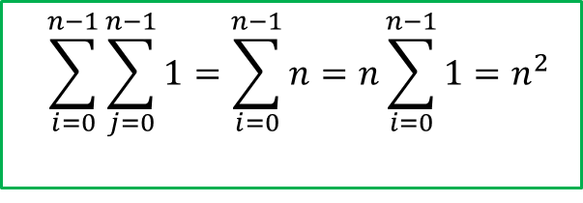

Find maximum difference pair in an array
Algorithm 1
static int MaxDiff1(int[] a)
{
int maxdiff = 0;
for (int i = 0; i < a.Length; i++)
for (int j = 0; j < a.Length; j++)
{
int diff = Math.Abs(a[i] - a[j]);
if (diff > maxdiff)
maxdiff = diff;
}
return maxdiff;
}
$$n^{2}$$
$$\sum_{i=0}^{n−1}{\sum_{j=0}^{n−1}{1}}=\sum_{i=0}^{n−1}{n}=n\sum_{i=0}^{n−1}{1}=n^{2}$$

Slide 14


Find maximum difference pair in an array
Algorithm 2
static int MaxDiff2(int[] a)
{
int maxdiff = 0;
for (int i = 0; i < a.Length; i++)
for (int j = i + 1; j < a.Length; j++)
{
int diff = Math.Abs(a[i] - a[j]);
if (diff > maxdiff)
maxdiff = diff;
}
return maxdiff;
}
$$n(n−1)/2$$
$$\sum_{i=0}^{n−1}{\sum_{j=i+1}^{n−1}{1}}=\sum_{i=0}^{n−1}{\left(n−1\right)−\left(i+1\right)+1}=\sum_{i=0}^{n−1}{n−i−1}=\sum_{i=0}^{n−1}{n−\sum_{i=0}^{n−1}{i−\sum_{i=0}^{n−1}{1}}}=n^{2}−\frac{n\left(n−1\right)}{2}−n=n(n−1)/2$$

Slide 15


Find maximum difference pair in an array
Algorithm 3
static int MaxDiff3(int[] a)
{
int max = int.MinValue;
int min = int.MaxValue;
for (int i = 0; i < a.Length; i++)
{
if (a[i] > max) max = a[i];
if (a[i] < min) min = a[i];
}
return max - min;
}
$$n$$
$$\sum_{i=0}^{n−1}{1}=n$$

Slide 16



Algo1 vs Algo2 vs Algo3
$$n^{2}$$
$$n(n−1)/2$$
$$n$$

Slide 17
Run-time Analysis
Empirical metrics
Complete code
Depend on language, machine, programmer, etc.
Growth rate
Only algorithm, no need to implement code
Count only the important command
Comparable result

Slide 18
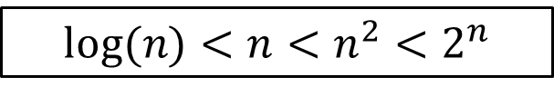
Growth rates
$$log⁡(n)<n<n^{2}{<2}^{n}$$

Slide 19


Example: Growth rate
Example 1:
Example 2:
for (int i = 0; i < n; i++)
for (int j = 0; j < n; j++)
sum += j;
$$\sum_{i=0}^{n−1}{\sum_{j=0}^{n−1}{1}}=\sum_{i=0}^{n−1}{n}=n\sum_{i=0}^{n−1}{1}=n^{2}$$
$$\sum_{i=1}^{n−1}{\sum_{j=3}^{n−2}{1}}=\sum_{i=1}^{n−1}{(n−4)}=\left(n−4\right)\sum_{i=1}^{n−1}{1}=\left(n−4\right)\left(n−1\right)=n^{2}−5n+4$$
for (int i = 1; i < n; i++)
for (int j = 3; j < n-1; j++)
sum += j;

Slide 20
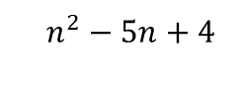
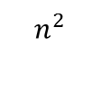




Example: Growth rate
$$n$$
$$n^{2}$$
$$r$$
$$n^{2}−5n+4$$
$$r$$
$$n\overset{→}{}∞$$
=

Slide 21

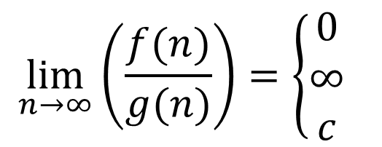
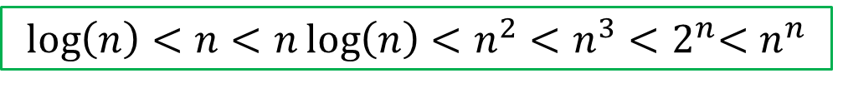


How to compare growth rate?
Recall limit:
$$\lim_{n→∞}\left(\frac{f(n)}{g(n)}\right)=\left\{\begin{matrix}0 \\ ∞ \\ c\end{matrix}\right.$$
$$f\left(n\right)<g(n)$$
$$f\left(n\right)>g(n)$$
$$f\left(n\right)=g(n)$$
$$\log\left(n\right)<n<n\log\left(n\right)<n^{2}<n^{3}{<2}^{n}<n^{n}$$
faster
slower

Slide 22



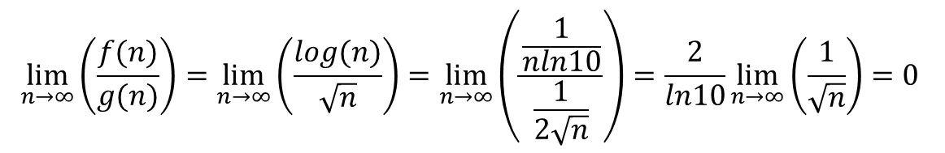
Example: Comparing growth rate
Which one grow faster?
Solution:
Answer:
$$f\left(n\right)=log⁡(n)$$
$$g\left(n\right)=\sqrt{n}$$
$$\lim_{n→∞}\left(\frac{f(n)}{g(n)}\right)=\lim_{n→∞}\left(\frac{log(n)}{\sqrt{n}}\right)=\lim_{n→∞}\left(\frac{\frac{1}{nln10}}{\frac{1}{2\sqrt{n}}}\right)=\frac{2}{ln10}\lim_{n→∞}\left(\frac{1}{\sqrt{n}}\right)=0$$
g$\left(n\right)$ grows faster than $f(n)$

Slide 23
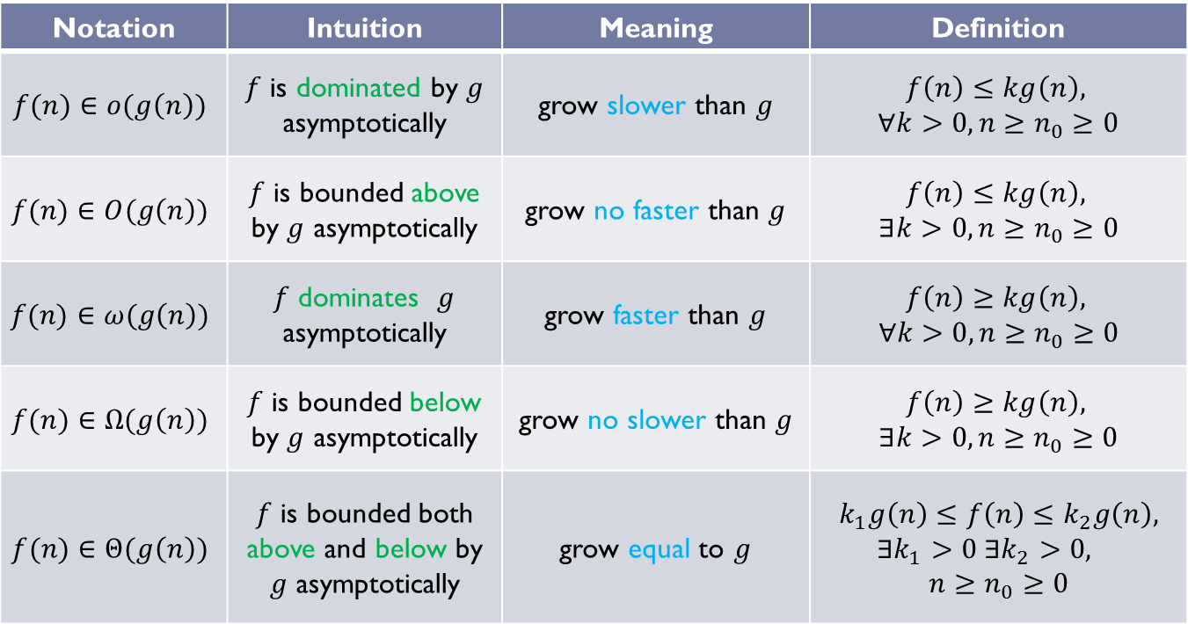
Asymptotic Notation
Bachmann–Landau notation
Notation | Intuition | Meaning | Definition
$$f(n)∈o(g\left(n\right))$$ | $f$ is dominated by $g$ asymptotically | grow slower than $g$ | $$f\left(n\right)≤kg\left(n\right),$$ $∀k>0, n≥n_{0}≥0$
$$f(n)∈O(g\left(n\right))$$ | $f$ is bounded above by $g$ asymptotically | grow no faster than $g$ | $$f\left(n\right)≤kg\left(n\right),$$ $$∃k>0, n≥n_{0}≥0$$
$$f(n)∈ω(g\left(n\right))$$ | $f$ dominates $g$ asymptotically | grow faster than $g$ | $$f\left(n\right)≥kg\left(n\right),$$ $$∀k>0,n≥n_{0}≥0$$
$$f(n)∈Ω(g\left(n\right))$$ | $f$ is bounded below by $g$ asymptotically | grow no slower than $g$ | $$f\left(n\right)≥kg\left(n\right),$$ $∃k>0, n≥n_{0}≥0$
$$f(n)∈Θ(g\left(n\right))$$ | $f$ is bounded both above and below by $g$ asymptotically | grow equal to $g$ | $$k_{1}g\left(n\right)≤f\left(n\right)≤k_{2}g\left(n\right), ∃k_{1}>0 ∃k_{2}>0,$$ $$n≥n_{0}≥0$$

Slide 24
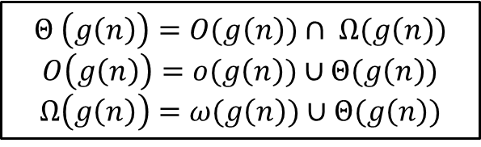






Asymptotic Notation
Meaning
$$ω(g\left(n\right))$$
$$Ω(g\left(n\right))$$
$$Θ(g\left(n\right))$$
$$O(g\left(n\right))$$
$$o(g\left(n\right))$$
Slower
$$g$$
Faster
$$Θ \left(g\left(n\right)\right)=O(g\left(n\right))∩ Ω(g\left(n\right))$$
$$O\left(g\left(n\right)\right)=o(g\left(n\right))∪Θ(g\left(n\right))$$
$$Ω\left(g\left(n\right)\right)=ω(g\left(n\right))∪Θ(g\left(n\right))$$

Slide 25





Definition of $O(g\left(n\right))$
$$O\left(g\left(n\right)\right)=\{f\left(n\right)|f\left(n\right)≤kg\left(n\right), ∃k>0, n≥n_{0}≥0\}$$
$$kg\left(n\right)$$
$$g\left(n\right)$$
$$f\left(n\right)$$
$$n_{0}$$

Slide 26

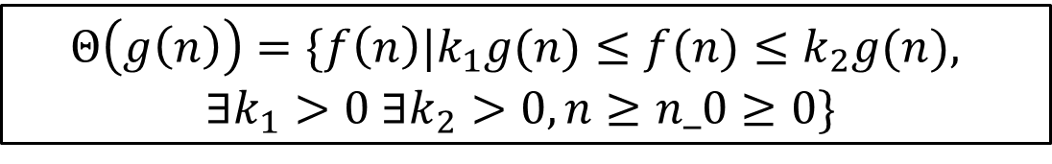



Definition of $Θ(g\left(n\right))$
$$Θ\left(g\left(n\right)\right)=\{f\left(n\right)|k_{1}g(n)≤f(n)≤k_{2}g(n),$$
$$∃k_{1}>0 ∃k_{2}>0,n≥n_0≥0\}$$
$$k_{2}g\left(n\right)$$
$$g\left(n\right)$$
$$f\left(n\right)$$
$$k_{1}g\left(n\right)$$
$$n_{0}$$

Slide 27
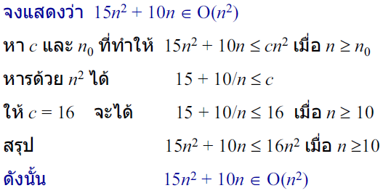
Example 1: Proof by definition
โครงสร้างข้อมูลฉบับวาจาจาวา, สมชาย ประสิทธ์จูตระกูล

Slide 28
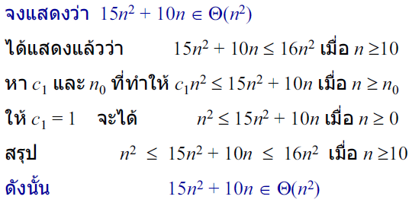
Example 2: Proof by definition
โครงสร้างข้อมูลฉบับวาจาจาวา, สมชาย ประสิทธ์จูตระกูล

Slide 29
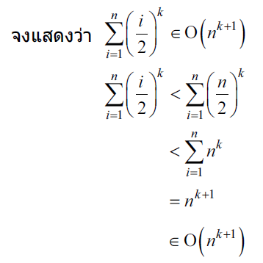
Example 3: Proof by definition
โครงสร้างข้อมูลฉบับวาจาจาวา, สมชาย ประสิทธ์จูตระกูล

Slide 30
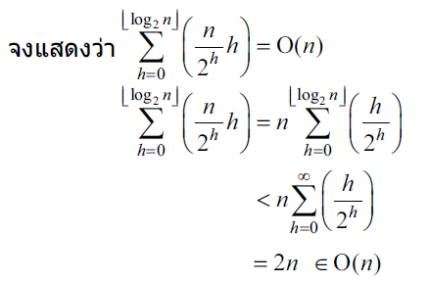
Example 4: Proof by definition
โครงสร้างข้อมูลฉบับวาจาจาวา, สมชาย ประสิทธ์จูตระกูล

Slide 31
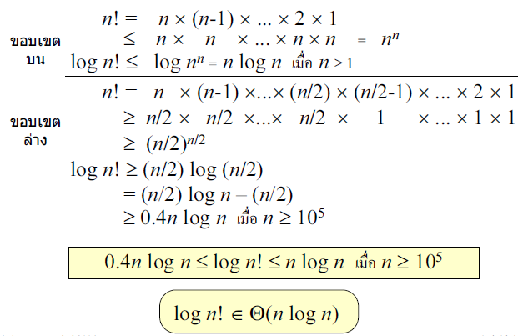
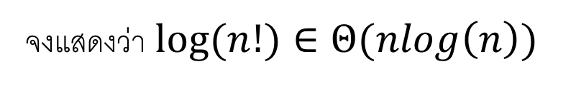
Example 5: Proof by definition
จงแสดงว่า $log⁡(n!)∈Θ(nlog\left(n\right))$
โครงสร้างข้อมูลฉบับวาจาจาวา, สมชาย ประสิทธ์จูตระกูล

Slide 32





















Example: Asymptotic Notation
$$Θ(1)$$
$$1$$
$$100$$
$$3^{100}$$
$$O(1)$$
$$Θ(log⁡(n))$$
$$2log⁡(n)$$
$$50\log\left(n\right)+9$$
$$O(log⁡(n))$$
$$Θ(n^{0.5})$$
$$12n^{0.5}+\log\left(n\right)$$
$$2n^{0.5}+{10}^{7}$$
$$O(n^{0.5})$$
$$Θ(nlog\left(n\right))$$
$$6nlog\left(n\right)+n$$
$$7log\left(n!\right)$$
$$O(nlog\left(n\right))$$
$$Θ(n^{5})$$
$2n^{5}$+ $n^{3}$
$9n^{5}$+ $2$
$$O(n^{5})$$

Slide 33
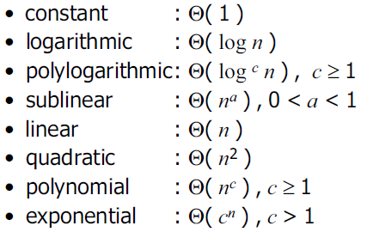
Some interesting functions
โครงสร้างข้อมูลฉบับวาจาจาวา, สมชาย ประสิทธ์จูตระกูล

Slide 34





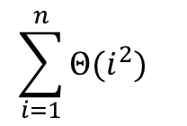

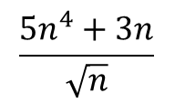



Class work1: Asymptotic Notation
Use the asymptotic notations $Θ$ and $O$ for each function of $n$
Proof that it is correct
$${4n}^{2}+2n+1$$
$$log(n^{10})$$
$${(2n+2)}^{5}$$
$$\log_{2}(n^{10})$$
$$\frac{{5n}^{4}+3n}{\sqrt{n}}$$
$$a_{k}n^{k}+a_{k−1}n^{k−1}+a_{k−2}n^{k−2}+⋯+a_{0}$$
$$\sum_{i=5}^{n}{Θ(i) }$$
$$2^{n+1}+3^{n+1000}$$
$$\sum_{i=1}^{n}{Θ(i^{2}) }$$
$$log\left(n!\right)+log⁡(n+1)$$

